Slide 1
Data Analytics & Intelligence
Chapter 1:
An Overview of Business Intelligence, Analytics, and Decision Support

Slide 2
Learning Objectives
Understand today’s turbulent business environment and describe how organizations survive and even excel in such an environment (solving problems and exploiting opportunities)
Understand the need for computerized support of managerial decision making
Understand an early framework for managerial decision making
(Continued…)

Slide 3
Learning Objectives
Learn the conceptual foundations of the DSS methodology
Describe the BI methodology and concepts and relate them to DSS
Describe the various types of analytics
List the major tools of computerized decision support

Slide 4
Changing Business Environment & Computerized Decision Support
Companies are moving aggressively to computerized support of their operations ⇨ Business Intelligence
Business Pressures–Responses–Support Model
Business pressures result of today's competitive business climate
Responses to counter the pressures
Support to better facilitate the process

Slide 5
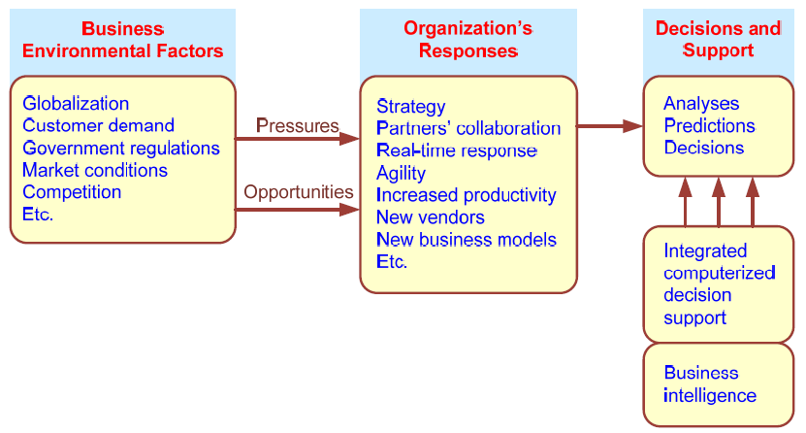
Business Pressures–Responses–Support Model

Slide 6
The Business Environment
The environment in which organizations operate today is becoming more and more complex, creating
opportunities, and
problems.
Example: globalization.
Four major categories of business environment factors:
markets, consumer demands, technology, and societal.

Slide 7
Business Environment Factors
FACTOR DESCRIPTION
Markets Strong competition
Expanding global markets
Blooming electronic markets on the Internet
Innovative marketing methods
Opportunities for outsourcing with IT support
Need for real-time, on-demand transactions
Consumer Desire for customization
demand Desire for quality, diversity of products, and speed of delivery
Customers getting powerful and less loyal
Technology More innovations, new products, and new services
Increasing obsolescence rate
Increasing information overload
Social networking, Web 2.0 and beyond
Societal Growing government regulations and deregulation
Workforce more diversified, older, and composed of more women Prime concerns of homeland security and terrorist attacks
Necessity of Sarbanes-Oxley Act and other reporting-related legislation Increasing social responsibility of companies
Greater emphasis on sustainability

Slide 8
Organizational Responses
Be Reactive, Anticipative, Adaptive, and Proactive
Managers may take actions, such as
Employ strategic planning
Use new and innovative business models
Restructure business processes
Participate in business alliances
Improve corporate information systems
Improve partnership relationships
Encourage innovation and creativity …cont…>

Slide 9
Managers actions, continued
Improve customer service and relationships
Move to electronic commerce (e-commerce)
Move to make-to-order production and on-demand manufacturing and services
Use new IT to improve communication, data access (discovery of information), and collaboration
Respond quickly to competitors' actions (e.g., in pricing, promotions, new products and services)
Automate many tasks of white-collar employees
Automate certain decision processes
Improve decision making by employing analytics

Slide 10
Closing the Strategy Gap
One of the major objectives of computerized decision support is to facilitate closing the gap between the current performance of an organization and its desired performance, as expressed in its mission, objectives, and goals, and the strategy to achieve them.

Slide 11
Managerial Decision Making
Management is a process by which organizational goals are achieved by using resources.
Inputs: resources
Output: attainment of goals
Measure of success: outputs / inputs
Management ≅ Decision Making
Decision making: selecting the best solution from two or more alternatives

Slide 12
The Nature of Managers’ Work Mintzberg's 10 Managerial Roles
Interpersonal
1. Figurehead (symbolic, routine)
2. Leader (motivation, activation, etc.)
3. Liaison (self-developed network of
outside contacts)
Informational
4. Monitor (nerve center of internal and external info.)
5. Disseminator (transmits from outsiders…)
6. Spokesperson (transmits to outsiders)
Decisional
7. Entrepreneur (searches for opportunities…)
8. Disturbance handler (corrective actions when org. faces important
unexpected disturbance)
9. Resource allocator (allocation of resources, approval of decisions)
10. Negotiator (representing the org. at major negotiations)
To perform these roles, managers need information that is delivered efficiently and in a timely manner.
In addition, managers need tools to support and improve decision making.

Slide 13
Decision-Making Process
Managers usually make decisions by following a four-step process (a.k.a. the scientific approach)
Define the problem (or opportunity)
Construct a model that describes the real-world problem.
Identify possible solutions to the modeled problem and evaluate the solutions.
Compare, choose, and recommend a potential solution to the problem.
Evidence-based decision making

Slide 14
Managers’ need for computerized Decision support
It is nearly impossible to rely on a trial-and-error approach to management, especially for decisions for which the factors shown in Table 1.1 (slide 7) are strong influences.
Managers must be more sophisticated; they must use the new tools and techniques of their fields.
Using them to support decision making can be extremely rewarding in making effective decisions.

Slide 15
Information Systems Support for Decision Making
Many trends have fostered IS-supported decision making:
Group communication and collaboration
Improved data management
Managing data warehouses and Big Data
Analytical support
Overcoming cognitive limits in processing and storing information
Knowledge management
Anywhere, anytime support

Slide 16
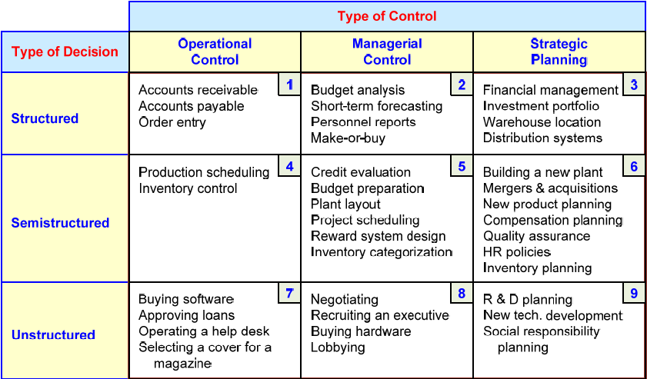
An Early Decision Support Framework (by Gory and Scott-Morten, 1971)

Slide 17
An Early Decision Support Framework
Degree of Structuredness (Simon, 1977)
Decisions are classified as
Highly structured (a.k.a. programmed)
Semi-structured
Highly unstructured (i.e., nonprogrammed)
Types of Control (Anthony, 1965)
Strategic planning (top-level, long-range)
Management control (tactical planning)
Operational control

Slide 18
Computer Support for types of decisions
Computer support for structured decisions
It is possible to use standard quantitative methods and rule-based decision support for automating portions of managerial decision making.
Computer support for Unstructured decisions
Can only be partially supported by standard quantitative methods.
Customized solutions that benefit from internal and external sources of data and information are necessary.
Human judgement may play a large role in these types of decisions.
Computer support for Semi-structured Problems
Involves a combination of standard solutions and human judgment.
A DSS can improve the quality of information on which the decision is based on, provide a range of alternatives along with their potential impacts.

Slide 19
The Concept of DSS
DSS - interactive computer-based systems, which help decision makers utilize data and models to solve unstructured problems
(Gorry and Scott-Morton, 1971)
Decision support systems couple the intellectual resources of individuals with the capabilities of the computer to improve the quality of decisions.
DSS as an Umbrella Term
Evolution of DSS into Business Intelligence

Slide 20
A Framework for Business Intelligence (BI)
BI is an evolution of decision support concepts over time
Then: Executive Information System (EIS)
Now: Business Intelligence (BI)
BI systems are enhanced with additional visualizations, alerts, and performance measurement capabilities
The term BI emerged from industry

Slide 21
Definition of BI
BI is an umbrella term that combines architectures, tools, databases, analytical tools, applications, and methodologies
BI is a content-free expression, so it means different things to different people
BI's major objective is to enable interactive access (may be in real time) to data (and models) to provide business managers with the ability to conduct analysis.
BI helps transform data, to information (and knowledge), to decisions, and finally to action

Slide 22
A Brief History of BI
The term BI was coined by the Gartner Group in the mid-1990s
However, the concept is much older
1970s - MIS reporting - static/periodic reports
1980s - Executive Information Systems (EIS)
1990s - OLAP, dynamic, multidimensional, ad-hoc reporting, forecasting and prediction, trend analysis -> coining of the term “BI”
2010s - Inclusion of AI and Data/Text Mining capabilities; Web-based Portals/Dashboards, Big Data, Social Media, Analytics

Slide 23
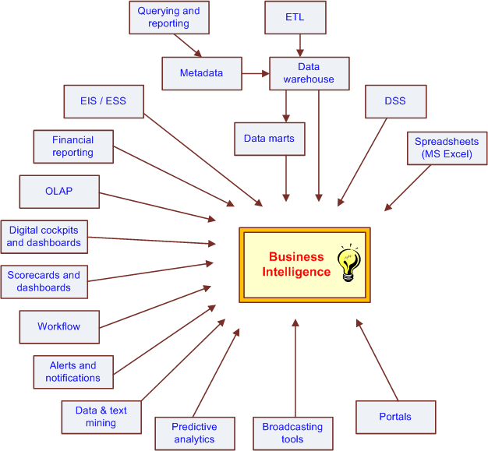
The Evolution of BI Capabilities

Slide 24
The Architecture of BI
A BI system has four major components
a data warehouse, with its source data
business analytics, a collection of tools for manipulating, mining, and analyzing the data in the data warehouse
business performance management (BPM) for monitoring and analyzing performance
a user interface (e.g., dashboard) allows access and easy manipulation of other BI components

Slide 25
A High-Level Architecture of BI

Slide 26

Business Value of BI Analytical Applications
Customer segmentation
Propensity to buy
Customer profitability
Fraud detection
Customer attrition
Channel optimization

Slide 27
Application Case 1.1
Sabre Helps Its Clients Through Dashboards and Analytics
Questions for Discussion
What is traditional reporting? How is it used in the organization?
How can analytics be used to transform the traditional reporting?
How can interactive reporting assist organizations in decision making?

Slide 28
A Multimedia Exercise in Business Intelligence
Teradata University Network (TUN)
www.teradatauniversitynetwork.com
BSI Videos (Business Scenario Investigations)
www.youtube.com/watch?v=NXEL5F4_aKA
Also look for other BSI Videos at TUN

Slide 29
DSS-BI Connections
Similarities and differences?
Similar architectures, data focus, …
BI implies the use of a data warehouse, whereas DSS may or may not have such a feature
Direct vs. indirect support
Different target audiences
Commercially available systems versus in-house development of solutions
Origination – Industry vs. Academia
So, is DSS = BI ?

Slide 30
Analytics Overview
Analytics?
Something new or just a new name for …
A Simple Taxonomy of Analytics (proposed by INFORMS)
Descriptive Analytics
Predictive Analytics
Prescriptive Analytics
Analytics or Data Science?

Slide 31
Analytics Overview

Slide 32
Application Case 1.2
Eliminating Inefficiencies at Seattle Children’s Hospital
Questions for Discussion
Who are the users of the tool?
What is a dashboard?
How does visualization help in decision making?
What are the significant results achieved by the use of Tableau?

Slide 33
Application Case 1.3
Analysis at the Speed of Thought
Questions for Discussion
What are the desired functionalities of a reporting tool?
What advantages were derived by using a reporting tool in the case?

Slide 34
Application Case 1.4
Moneyball: Analytics in Sports and Movies
Questions for Discussion
How is predictive analytics applied in Moneyball?
What is the difference between objective and subjective approaches in decision making?

Slide 35
Application Case 1.5
Analyzing Athletic Injuries
Questions for Discussion
What types of analytics are applied in the injury analysis?
How do visualizations aid in understanding the data and delivering insights into the data?
What is a classification problem?
What can be derived by performing sequence analysis?

Slide 36
Application Case 1.6
Industrial and Commercial Bank of China (ICBC) Employs Models to Reconfigure Its Branch Networks
Questions for Discussion
How can analytical techniques help organizations to retain competitive advantage?
How can descriptive and predictive analytics help in pursuing prescriptive analytics?
What kind of prescriptive analytic techniques are employed in the case study?
Are the prescriptive models once built good forever?

Slide 37
End-of-Chapter Application Case
Nationwide Insurance Used BI to Enhance Customer Service
Questions for Discussion
Why did Nationwide need an enterprise-wide data warehouse?
How did integrated data drive the business value?
What forms of analytics are employed at Nationwide?
With integrated data available in an enterprise data warehouse, what other applications could Nationwide potentially develop?

